Slide 1
FORAGE TASK 1- Web Scraping Overview
Total reviews= 3923
Verified trips= 2086
Unverified trips= 312
Trips neither verified or unverified= 1525

Slide 2
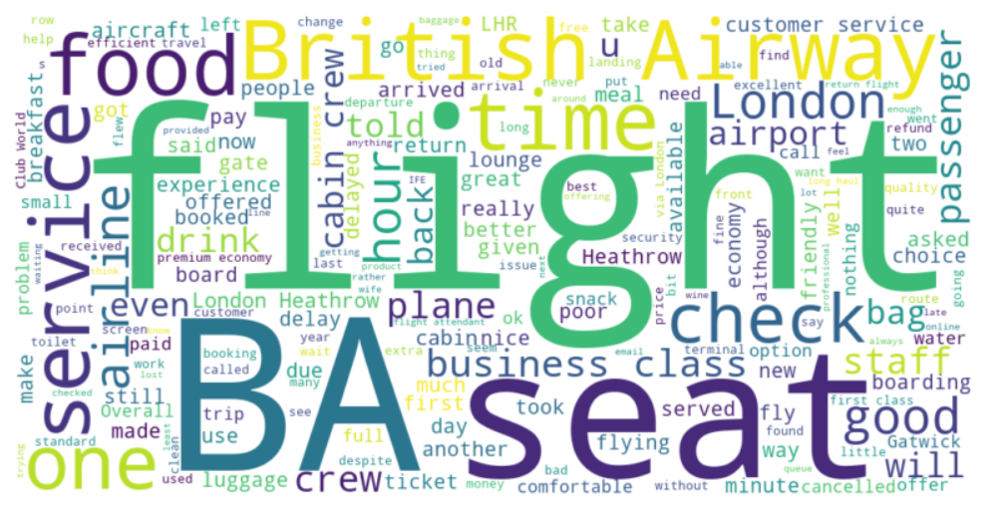
Analysis For Verified Trips
Most used words:
flight
BA
seat
check
british
airway
service
food
time
good

Slide 3
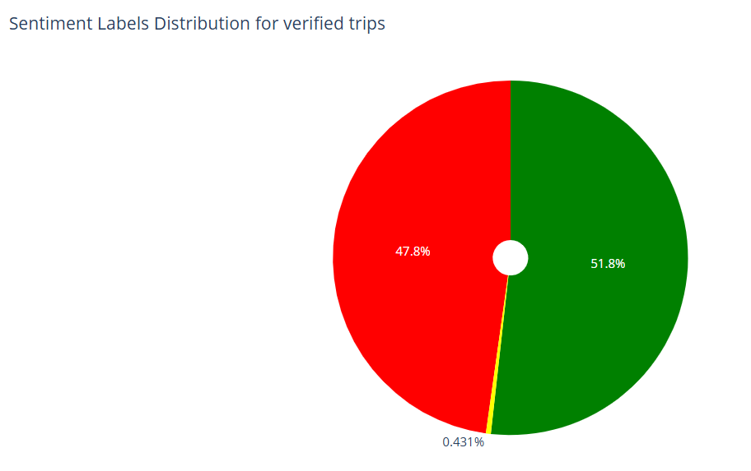
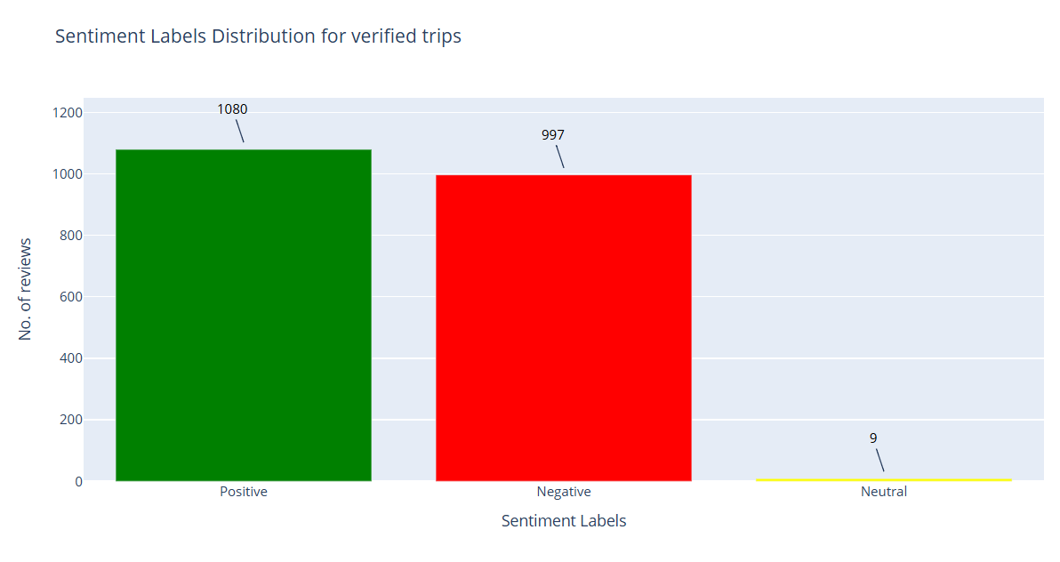
Analysis For Verified Trips
From a total of 2086 reviews:
Positive reviews= 1080 (51.8%)
Negative reviews= 997 (47.8%)
Neutral reviews= 9 (0.43%)

Slide 4
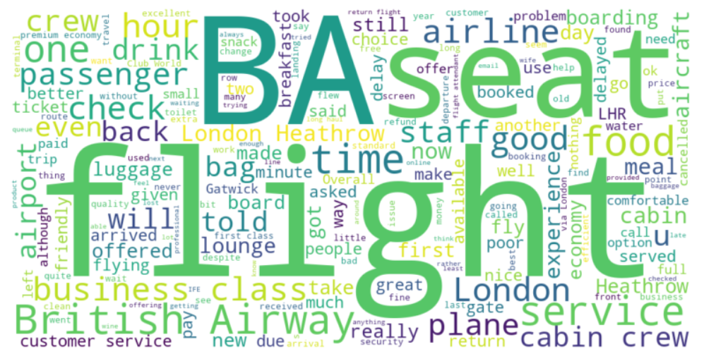
Analysis For Unverified Trips
Most used words:
flight
BA
seat
London
british
airway
airline
food
time
good

Slide 5
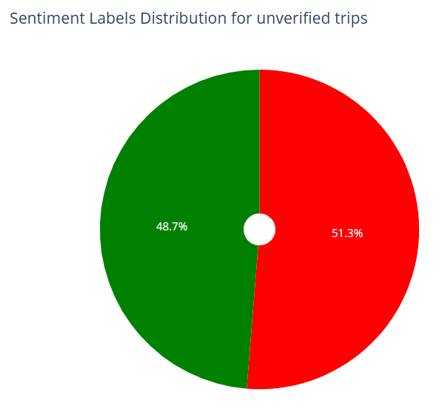
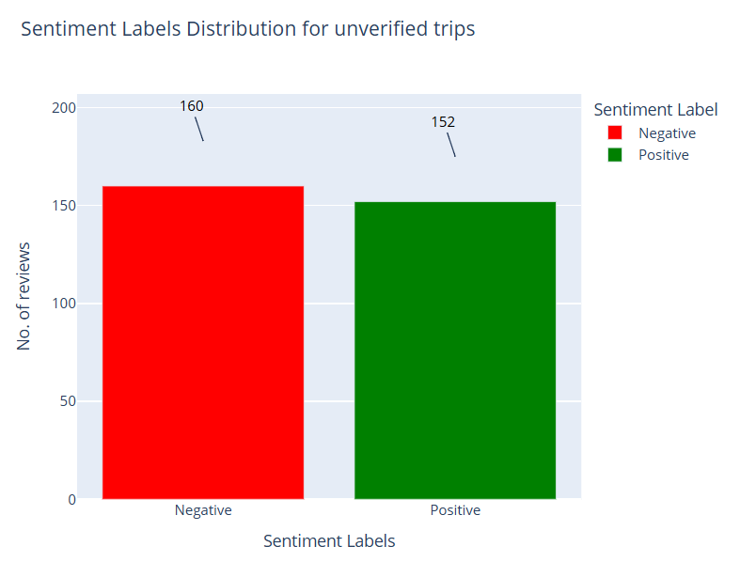
Analysis For Unverified Trips
From a total of 312 reviews:
Positive reviews= 152 (48.7%)
Negative reviews= 160 (51.3%)

Slide 6
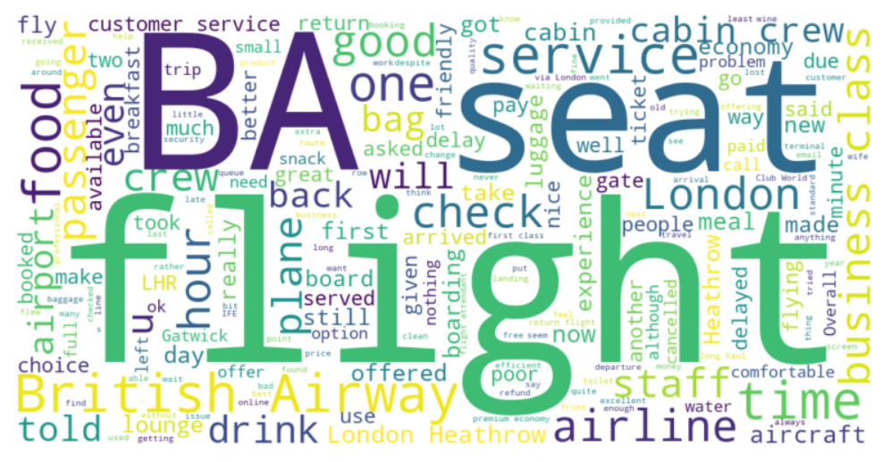
Analysis For Neither Verified Nor Unverified Trips
Most used words:
flight
BA
seat
check
british
airway
service
food
London
one

Slide 7
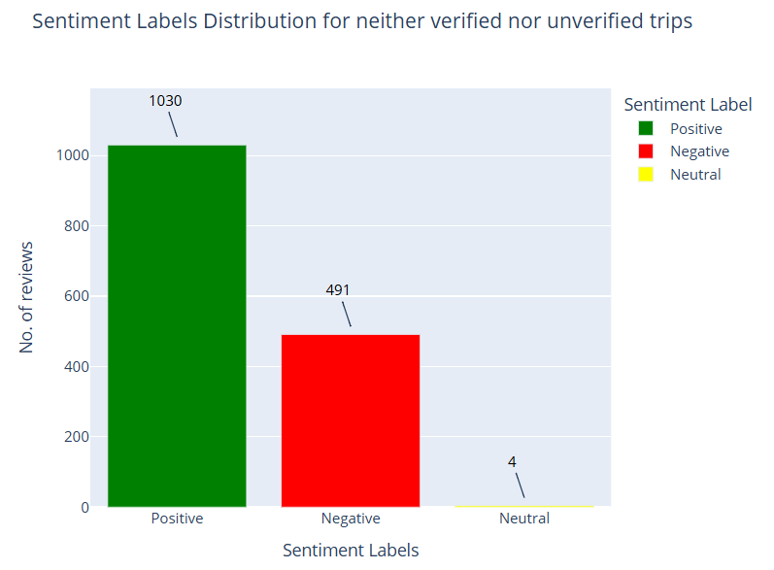
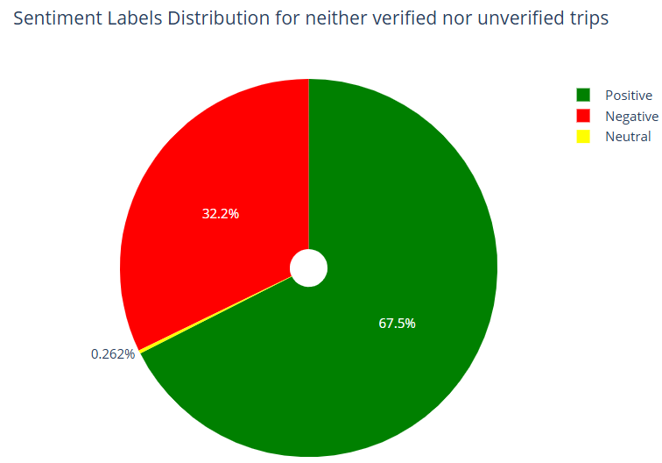
Analysis For Neither Verified Nor Unverified Trips
From a total of 1525 reviews:
Positive reviews= 1030 (67.5%)
Negative reviews= 491 (32.2%)
Neutral reviews= 4 (0.26%)

